Slide 1
Relationship between Occupational Injury Probability and Risk Perception in Industry Committee Update Meeting 2022 Yenny Fariñas Diaz
Department of Environmental Health Sciences
Robert Stempel College of Public Health and Social Work

Slide 2
Committee Members
Committee Member | Department
Dr. Roberto Lucchini, Professor Major Professor (Committee Chair) | Dept. of Environmental Health Sciences
Dr. Jeremy Chambers, Ph.D, Assistant Professor Director of Doctoral Programs, Department of Environmental Health Sciences Committee Member | Dept. of Environmental Health Sciences
Dr. Shanna L. Burke, MSW, LCSW, PhD, Assistant Professor Committee Member | Dept. of School of Social Work
Dr. Deodutta Roy, PhD, Professor Committee Member | Dept. of Environmental Health Sciences
Dr. Emir Veledar, Ph.D., Courtesy Graduate Faculty Appointment Director of Biostatistics and Predictive Analytics at Baptist Health Committee Member | Dept. of Biostatistics

Slide 3
Background
Understanding risk perception and the associated human behaviors are key in understanding how individuals react to hazards and how a culture of safety is developed. In order to understand this perception, we first need to be able to model and classify injuries and fatalities across industry.
Our belief is that within an industry and relative to other industries, the number of injuries and fatalities will average to a value, for a given industry over time. These values will be formulated into a mathematical equation, that will be subsequently used to calculate the inherent injury and fatality probability for a given industry.
A secondary data analysis of documented workplace injuries for over nine hundred (900) occupations within an eight (8) year period is being conducted. The analysis will examine the correlation of injury and fatalities for each given industry.
A model will be developed to represent if a relationship exists between industry, gender, age, and race in relation to Fatalities and Injuries.
The general intent of the study. is to develop a predictive model of injury and fatality rates across industry over time, to determine if these rates collapse into a known equation that can be used to predict injury and fatality rates.

Slide 4
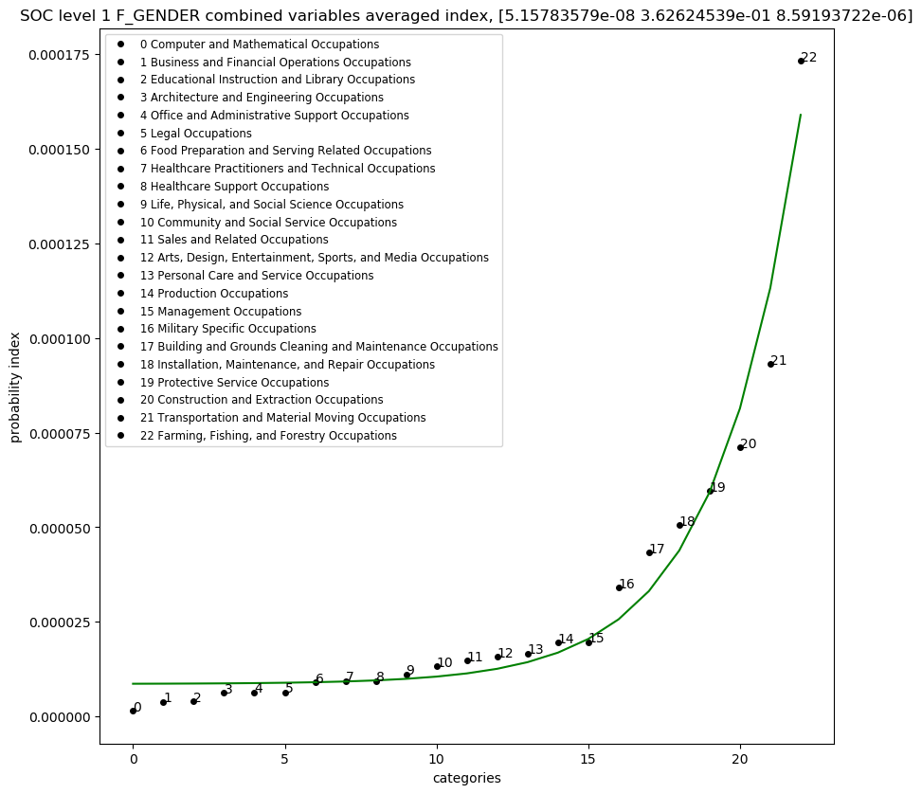
Hypothesis
Fatality and Injury prediction
We hypothesize that occupational rates of injury and fatalities over time average to a known value, and these known values can be projected into a model of calculated probabilities that can be used to determine an ultimate combined probability.
A final model will be created, such that the probability of fatality(PF) or injury(PI) can be predicted based on the following variables: occupation, gender, age, race, and length of service.
P_{fatality} = PF _{gender} (occupation) * PF _{age} (occupation) * PF _{race} (occupation)
P_{injury} = PI _{gender} (occupation) * PI _{age} (occupation) * PI _{race} (occupation)
Gender
probability
occupation
Figure 1: Graphical Representation of Hypothesis.

Slide 5
Innovative contribution:
In our analysis we assigned each industry a known integer value. The job categories were sorted based on fatality and injury rates. Our assertion is that this structure, can be proved, that it will not change over time, and that an industry's inherent risk(injury/fatality) is constant. Thereby allowing it to be used as a measure of risk. This measure of injury or fatality risk will be used to calculate an overall probability of fatality or injury over time.
A nonlinear regression for the data collected will be performed. All regressions will yield three values A,B,C which fit the following equation:
Probability = A * e^{(B*X)} + C
where X is the integer value selected for a given occupation, and [A|B|C] are coefficients that determine the final equation
A final predictive model will be created, such that the probability of fatality(PF) or injury(PI) can be predicted based on the following variables: occupation, gender, age, race, and length of service.
P_{fatality} = PF _{gender} (occupation) * PF _{age} (occupation) * PF _{race} (occupation)
P_{injury} = PI _{gender} (occupation) * PI _{age} (occupation) * PI _{race} (occupation)

Slide 6
Specific Aims
Aim1: (Occupational Risk)
To examine the likelihood that occupational risk for a given industry can be predicted by using an equation that calculates a given probability for injury or fatality.
Will evaluate:
What the effect of variables such as: Type of occupation, Age, Gender, ands Race has on fatalities and injuries.
Aim 2: (Risk Perception)
To examine the correlation of injury on fatalities and fatalities on injuries. Is this due to a risk perception or just part on an inherent effect.
Will evaluate:
if there is a correlation between occupational injuries and fatalities given any type of occupation.

Slide 7
Data Normalization
The US Department of Labor Bureau of Labor Statistics collects industry events for nonfatal injuries and fatal injuries as well. However, it does not collect the total number of outstanding contributors.
For example, an industry may not have the same distribution of males or females, so in order to obtain an incident rate per gender this total would be needed.
Therefore, the US department of Labor conducts surveys called CPS (Current Population Surveys) in order to account for the needed cumulative totals.
https://www.bls.gov/cps/
In our data analysis we normalized the total incident amounts reported (in the thousands), by the total given population (in the thousands)
Therefore, the values that we are analyzing would be probabilities of injuries and fatalities for each industry for a given independent variable.
Total Fatalities or Injuries (occupation and (gender or age or race) )
Probability = ------------------------------------------------------------------------------------------
Total population for given occupation and (gender or age or race)

Slide 8
DATA STORAGE

Slide 9
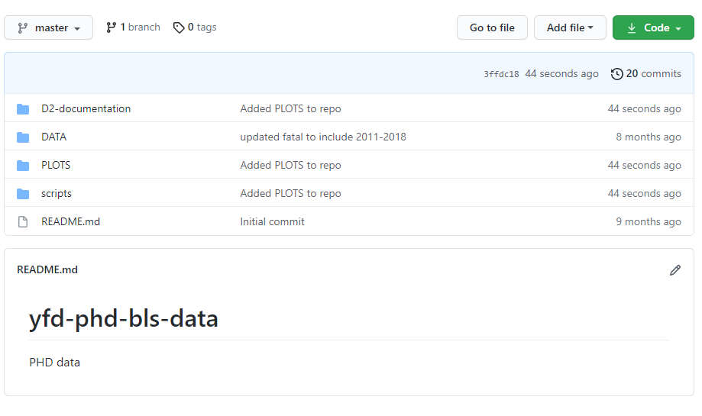
Data Repository Location
https://github.com/ehsintegration/yfd-phd-bls-data
All DATA is kept in the GITHUB depository located in the link above.
The SCRIPTS folder contains the analysis and (RESULTS) for each variable where the graphs are also embed and located within the program itself, or within the PLOTS directory.
DATA
PLOTS
SCRIPTS
Figure 2: GITHUB repository location.

Slide 10
POPULATION SIZE

Slide 11
Approach: Sample Population and Sample Size
Sample population:
A total of 8 years of Injury, Illness and Fatalities data from the United States Department of labor from 2011 through 2018 in Private Industry in the United States.
The injury and fatality data is representative of various private sector industries reported to the United States Department of labor, of which all will be used for this study.
This study only analyses those injuries deemed to be recordable or resulting in a fatality.
A recordable injury is defined by the Occupational Safety and Health Administration (OSHA) recordkeeping standard in the Code of Federal Regulations as a fatality or “Any work-related injury or illness that results in loss of consciousness, days away from work, restricted work, or transfer to another job. Any work-related injury or illness requiring medical treatment beyond first aid” (OSHA, 29 C.F.R.§1904.7 Subpart C, 2001).
Required Sample size:
Alpha levels were set at 0.05 (95% confidence level), with a 5% margin of error, therefore requiring a population size of a minimum of 385.
Our analysis in the GIT repository, shows that the collected data points in the study exceeds the required sample size of 385.

Slide 12
DATA OVERVIEW

Slide 13
Data Overview
The data collected is publicly available as these industries are subject to reporting their injuries, illnesses and fatalities to their corresponding state once an employee has incurred a recordable case and annually to the US Department of Labor Bureau of Labor Statistics.
Data availability: The data will be retrieved from Federal databases from the US Department of Labor (U.S. Bureau of Labor Statistics, 2022).
Multi-screen data search (2011-2018): https://www.bls.gov/iif/data.htm (U.S. Bureau of Labor Statistics, 2022).
Data collected and converted to CSV format was stored at : https://github.com/ehsintegration/yfd-phd-bls-data/tree/master/DATA
Copyrights, publications, licensing and data protection, : https://www.bls.gov/opub/ (U.S. Bureau of Labor Statistics, 2022).
Licensing: The data retrieved from “Data.gov” can be used without cost or a licensing requirement.
Copyrights, publications: The Bureau of Labor Statistics requests that they be cited when the data is used.
Data protection: The data is protected in an official site “Data.gov” from the US Government and it complies with Computer Fraud and Abuse Act of 1986 and the National Information Infrastructure Protection Act. The data integrity of the injured or deceased employee has already been protected by the collecting entity.
Notes:
Converting to CSV format was a challenging process.

Slide 14
Data Overview
SOCJOBCODE
For our proposed risk analysis, we will be:
Obtained fatality and workplace injury data from the department of US Labor Statistics.
Collected data for over for over nine hundred (900) occupations within an eight (8) year period.
We also have multiple datasets for different INJURY and FATALITY counts by categories of: OCCUPATION, GENDER, AGE, RACE .
The SOCJOBCODE:
Is a numerical categorical classification system, that is used to encode the occupational type. It is encoded such that it can also be used as an independent variable.
It is a six-digit number, where the numeric place value implements an administrative encoding.
The numerical range of this encoding is also enumerated in increasing risk order, where the job classifications at the higher value range represents occupations with a lower degree of administrative type work but higher risk jobs.
Administrative
(Lower risk jobs)
11-XXXX Management Occupations
13-XXXX Business and Financial Operations Occupations
15-XXXX Computer and Mathematical Occupations
17-XXXX Architecture and Engineering Occupations
19-XXXX Life, Physical, and Social Science Occupations
21-XXXX Community and Social Service Occupations
23-XXXX Legal Occupations
25-XXXX Educational Instruction and Library Occupations
27-XXXX Arts, Design, Entertainment, Sports, and Media Occupations
29-XXXX Healthcare Practitioners and Technical Occupations
31-XXXX Healthcare Support Occupations
33-XXXX Protective Service Occupations
35-XXXX Food Preparation and Serving Related Occupations
37-XXXX Building and Grounds Cleaning and Maintenance Occupations
39-XXXX Personal Care and Service Occupations
41-XXXX Sales and Related Occupations
43-XXXX Office and Administrative Support Occupations
45-XXXX Farming, Fishing, and Forestry Occupations
47-XXXX Construction and Extraction Occupations
49-XXXX Installation, Maintenance, and Repair Occupations
51-XXXX Production Occupations
53-XXXX Transportation and Material Moving Occupations
55-XXXX Military Specific Occupations
Non-Administrative (Higher risk jobs)
Figure 3: SOC level 1 risk profile.

Slide 15
Data Normalization
The US Department of Labor Bureau of Labor Statistics collects industry events for nonfatal injuries and fatal injuries as well. However, it does not collect the total number of outstanding contributors.
For example, an industry may not have the same distribution of males or females, so in order to obtain an incident rate per gender this total would be needed.
Therefore, the US department of Labor conducts surveys called CPS (Current Population Surveys) in order to account for the needed cumulative totals.
https://www.bls.gov/cps/
In our data analysis we normalized the total incident amounts reported (in the thousands), by the total given population (in the thousands)
Therefore, the values that we are analyzing would be probabilities of injuries and fatalities for each industry for a given independent variable.
Total Fatalities or Injuries (occupation and (gender or age or race) )
Probability = ------------------------------------------------------------------------------------------
Total population for given occupation and (gender or age or race)

Slide 16
Data Overview: Analysis (Occupation Type: SOC Standard Occupational Classification)
Each SOC job category number is used to encode a branch of occupation. The SOC job code consists of 6 numbers, that when read from left to right will further subdivide the group into more specifications. The job code is used to denote a location in a TREE of occupations.
11-0000 Management Occupations
11-1000 Top Executives
11-1010 Chief Executives
11-1011 Chief Executives
11-1020 General and Operations Managers
11-1021 General and Operations Managers
11-1030 Legislators
11-1031 Legislators
11-2000 Advertising, Marketing, Promotions, Public Relations,
and Sales Managers
11-2010 Advertising and Promotions Managers
11-2011 Advertising and Promotions Managers
11-2020 Marketing and Sales Managers
11-2021 Marketing Managers
11-2022 Sales Managers
11-2030 Public Relations Managers
11-2031 Public Relations Managers
11-3000 Operations Specialties Managers
11-3010 Administrative Services Managers
11-3011 Administrative Services Managers
11-3020 Computer and Information Systems Managers
.
.
.
.
.
11-9140 Property, Real Estate, and Community AssociationManagers
11-9141 Property, Real Estate, and Community Association Managers
11-9150 Social and Community Service Managers
11-9151 Social and Community Service Managers
11-9190 Miscellaneous Managers
11-9199 Managers, All Other
13-0000 Business and Financial Operations
13-1000 Business Operations Specialists
13-1010 Agents and Business Managers of Artists, Performers, and Athletes
13-1011 Agents and Business Managers of Artists, Performers, and Athletes
13-1020 Buyers and Purchasing Agents
13-1021 Purchasing Agents and Buyers, Farm Products
13-1022 Wholesale and Retail Buyers, Except Farm Products
13-1023 Purchasing Agents, Except Wholesale, Retail, and Farm Products
13-1030 Claims Adjusters, Appraisers, Examiners, and Investigators
13-1031 Claims Adjusters, Examiners, and Investigators
13-1032 Insurance Appraisers, Auto Damage
13-1040 Compliance Officers, Except Agriculture, Construction, Health and Safety, and Transportation
13-1041 Compliance Officers, Except Agriculture, Construction, Health and Safety, and Transportation
13-1050 Cost Estimators
13-1051 Cost Estimators
13-1060 Emergency Management Specialists
13-1061 Emergency Management Specialists
13-1070 Human Resources, Training, and Labor Relations
.
.
(https://github.com/ehsintegration/yfd-phd-bls-data/blob/master/DATA/SOC_all.xlsx)
The following file contains all the standard occupational coding that is used to index the data (all SOC codes).

Slide 17
Data Overview: Analysis (Occupation Type: SOC Standard Occupational Classification)
11-XXXX Management Occupations
13-XXXX Business and Financial Operations Occupations
15-XXXX Computer and Mathematical Occupations
17-XXXX Architecture and Engineering Occupations
19-XXXX Life, Physical, and Social Science Occupations
21-XXXX Community and Social Service Occupations
23-XXXX Legal Occupations
25-XXXX Educational Instruction and Library Occupations
27-XXXX Arts, Design, Entertainment, Sports, and Media Occupations
29-XXXX Healthcare Practitioners and Technical Occupations
31-XXXX Healthcare Support Occupations
33-XXXX Protective Service Occupations
35-XXXX Food Preparation and Serving Related Occupations
37-XXXX Building and Grounds Cleaning and Maintenance Occupations
39-XXXX Personal Care and Service Occupations
41-XXXX Sales and Related Occupations
43-XXXX Office and Administrative Support Occupations
45-XXXX Farming, Fishing, and Forestry Occupations
47-XXXX Construction and Extraction Occupations
49-XXXX Installation, Maintenance, and Repair Occupations
51-XXXX Production Occupations
53-XXXX Transportation and Material Moving Occupations
55-XXXX Military Specific Occupations
SOC Level 1 – Cumulative Count
The X’s represent a don’t care condition. Which means it is a wildcard that represents all possible values.
XXXX-mask
This XXXX-mask nomenclature represents a cumulative count for all sublevel occupations within that structure.
Our mathematical analysis scripts parse all of the sublevel occupations and groups them to obtain a final count for the complete group.
Figure 3: SOC level 1 risk profile.

Slide 18
Data Analysis: Example of SOC Tree Branch
Here is an example of the TREE encoding system, with further descendant selectivity. The “X”s below can be viewed as a don’t care.
The occupational code is a 6 different number that clusters occupations into finer and finder resolutions.
Therefore a occupational index of “23XXXX” will select all “legal occupations”
And a occupational index of “231XXX” will select all “lawyers, judges, and related workers”
And a occupational index of “231011” will select all “lawyers”
Administrative
11-XXXX Management Occupations
13-XXXX Business and Financial Operations Occupations
15-XXXX Computer and Mathematical Occupations
17-XXXX Architecture and Engineering Occupations
19-XXXX Life, Physical, and Social Science Occupations
21-XXXX Community and Social Service Occupations
23-XXXX Legal Occupations
25-XXXX Educational Instruction and Library Occupations
27-XXXX Arts, Design, Entertainment, Sports, and Media Occupations
29-XXXX Healthcare Practitioners and Technical Occupations
31-XXXX Healthcare Support Occupations
33-XXXX Protective Service Occupations
35-XXXX Food Preparation and Serving Related Occupations
37-XXXX Building and Grounds Cleaning and Maintenance Occupations
39-XXXX Personal Care and Service Occupations
41-XXXX Sales and Related Occupations
43-XXXX Office and Administrative Support Occupations
45-XXXX Farming, Fishing, and Forestry Occupations
47-XXXX Construction and Extraction Occupations
49-XXXX Installation, Maintenance, and Repair Occupations
51-XXXX Production Occupations
53-XXXX Transportation and Material Moving Occupations
55-XXXX Military Specific Occupations
We can also see that the numbering system increases in a numerical order, in proportionality to human physical manual difficulty.
Non-Administrative
Figure 3: SOC level 1 risk profile.

Slide 19
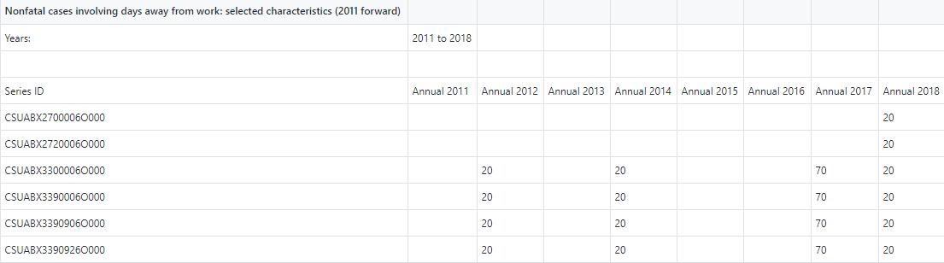
All the data was collected from the US department of Labor and uploaded to a GITHUB repository. A series of Jupyter python programs was created to parse the data for analysis. The data is stored as individual files for each independent variable:
In each file you will find eight sample values for each SOC job category, as shown below:
Data Overview: Methodology (file structure)
Independent Variables → | Age | Gender | Race
Type of Variable → | Categorical Continuous | Categorical | Categorical
 | NF_AGE_14to15_all.xlsx NF_AGE_16to19_all.xlsx NF_AGE_20to24_all.xlsx NF_AGE_25to34_all.xlsx NF_AGE_35to44_all.xlsx NF_AGE_45to54_all.xlsx NF_AGE_55to64_all.xlsx NF_AGE_65plus_all.xlsx NF_AGE_NR_all.xlsx | NF_GENDER_F_all.xlsx NF_GENDER_M_all.xlsx NF_GENDER_NR_all.xlsx | NF_RBX_Asian_all.xlsx NF_RDX_Hispanic_all.xlsx NF_REX_Hawaiian_all.xlsx NF_RFX_White_all.xlsx NF_RGX_NR_all.xlsx NF_RHX_Multi_all.xlsx NF_RIX_Hispanic_all.xlsx NF_RCX_Black_AfricanAmerican_all.xlsx NF_RAX_AmericanIndian_AlaskaNative_all.xlsx
Figure 4: File name and content structure.
Notes:
Shows the data files. How it looks like and how the files correlates to the variables.

Slide 20
MODEL

Slide 21
Approach: Dependent and Independent Variables
Summary of Variables:
Dependent Variable: 2 main outcome variable of interest are: probability of injury and probability of fatality.
Independent variables of interest: 4: (occupation, gender, age, race).
Table 1
Dependent and Independent Variables
Dependent Variables (Risk) | Types of Variables
Probability of Injury/Fatality (Derived from job encoding) | Continuous
Independent Variables (Risk Perception) (Occupational Recordable Injury, Illnesses and Fatalities for each) | Types of Variables
Age | Categorical/Continuous
Gender, Race | Categorical
Occupation | Categorical/Continuous
Note: Might have to flip my graphs so that Risk Perception is on the X axis and Risk is on the Y axis.
Artificial system was created for Risk ranging from (0.0 to 22.0). We took the enumerated categories and turned it into a real number ranging from (0.0 to 22.0).
Notes:
Might have to flip my graphs so that Risk Perception is on the X axis and Risk is on the Y axis.
Artificial system was created for Risk ranging from (0.0 to 22.0).
We took the enumerated categories and turned it into a real number ranging from (0.0 to 22.0).

Slide 22
Approach: Description of Independent Variables
Table 2a
Description of Independent Variables
Independent Variables → | Age | Gender | Race | Occupation Type
Type of Variable → | Categorical Continuous | Categorical | Categorical | Categorical/Continuous
 | 14-15 Yrs.' 16-19 Yrs.' 20-24 Yrs.' 25-34 Yrs.' 35-44 Yrs.' 45-54 Yrs.' 55-64 Yrs.' 65 Yrs.' + Not Reported | Male Female Not Reported | Asian African American/Black (non-Hispanic) Hispanic/Latino White Multi Race | Life Scientists Biological Scientists Medical Scientists Physical Scientists Chemists & Material Scientists Chemists Biological Technicians Chemical Technicians Health Technologists & Technicians Clinical Laboratory Technologists & Technicians Medical & Clinical Lab Techologists Medical & Clinical Lab Technicians Production Occupations (for Manufacturing)

Slide 23
Approach: Description of Dependent Variables
Table 2b
Description of Dependent Variables
Dependent Variables → | Probability of Injury and /Fatality
Type of Variable → | Categorical/Continuous

Slide 24
Approach: Description of Independent Variables (file names in data repository)
https://github.com/ehsintegration/yfd-phd-bls-data/tree/master/DATA
Table 3
Description of Independent Variables (File List) , list of data files for each variable.
Independent Variables → | Age | Gender | Race
Type of Variable → | Categorical Continuous | Categorical | Categorical
 | NF_AGE_14to15_all.xlsx NF_AGE_16to19_all.xlsx NF_AGE_20to24_all.xlsx NF_AGE_25to34_all.xlsx NF_AGE_35to44_all.xlsx NF_AGE_45to54_all.xlsx NF_AGE_55to64_all.xlsx NF_AGE_65plus_all.xlsx NF_AGE_NR_all.xlsx | NF_GENDER_F_all.xlsx NF_GENDER_M_all.xlsx NF_GENDER_NR_all.xlsx | NF_RBX_Asian_all.xlsx NF_RDX_Hispanic_all.xlsx NF_RFX_White_all.xlsx NF_RGX_NR_all.xlsx NF_RHX_Multi_all.xlsx NF_RCX_Black_AfricanAmerican_all.xlsx

Slide 25
Approach: Model
Data Selector/
Equation
---2011
---2012
..
---2018
---2011
---2012
..
---2018
---2011
---2012
..
---2018
Fatality Data
Injury Data
(used for model creation)
Scientist:
191000 Life Scientist
191020 Biological Scientist
192030 Chemist Scientist
.
.
Laboratories:
292010 Clinical Laboratory
292011 Medical Laboratory
.
.
Independent Variables
Occupation
Age
Gender
Race
Production:
113050 Production Managers
435060 Production Clerks
510000 Production Occupations
.
.
Probability of Injury and Probability of Fatality
Dependent Variable (Risk)
Figure 5: Risk Probability Model.

Slide 26
MATHEMATICAL OVERVIEW

Slide 27
Mathematical Summary: Overview
Now that we are familiar with the data files and their contents, we can further explore the type of data collected and the reasoning behind it.
In our analysis we are creating a single averaged value for each of the eight years, for each SOC job code. This averaging helps to determine the mean value for each occupation. This mean will be used as a variable for the final calculation of probability. The probability for each classification will be multiplied together in order to obtain a final probability of injury or fatality for the given independent variables.
Where X is the occupational integer number, and A,B,C are the given coefficients for a linear regression.
Probability _{(Gender or age or race)} = A * e^{(B*X)} + C
P_{fatality} = PF _{gender} (occupation) * PF _{age} (occupation) * PF _{race} (occupation)
P_{injury} = PI _{gender} (occupation) * PI _{age} (occupation) * PI _{race} (occupation)
Notes:
Take all the jobs and collapsed them together.
For each SOC code, averaged the age years into one value, then took the averaged fatality and divided by the averaged injury for that specific SOC code.

Slide 28
Next Steps : Statistical Options Considered
Table 5
Statistical options.
Statistical Analysis Selected | Why | Comments
Pearson’s correlations will be used to determine the relationship between risk exposure and injury. | Measures the association between the variables. Used to measure strength of the association. | Used to find R-Squared.
A univariate linear regression model will be used to investigate the relationship between injury status and individual potential risk factors. | Used to determine single variable relationship between dependent and independent variables. | Single variable regression equation.
A multivariate linear regression model will be used to examine the influence of a combination of risk factors for becoming injured. | Used to determine a multi variable relationship between the independent variables and the dependent. | All variable regression equation.

Slide 29
Next Steps : Statistical Options
Table 5 (cont.)
Statistical options.
Statistical Analysis Selected | Why | Comments
Covariates will be fitted into the model using a forward selection procedure and will retain in the final linear regression model if they reached a statistical threshold of p<0.10 or were of significance. | Begin with no candidate variables in the model. Select the variable that has the highest R-Squared. (from Pearson) Select the candidate variable that increases R-Squared the most. Stop adding variables when none of the remaining variables are significant p<0.10. | Used to find independent variables for the final regression model.
A logistic regression will be used to investigate the relationship between injury severity and possible risk factors. | Can analyze cut offs, binary categories. Example, does having more than 5 years experience a factor, also analyze age cut offs, or gender. | Binary category analysis.
All statistical analysis will be conducted using Jupyter and/or R Studio, which is a data analytics tools that is commonly being used to analyze publicly available data. The data will be pulled from DOL but it will be stored in the Github depository. Bloxplots, data distribution, linear regression were conducted. | https://github.com/ehsintegration/risk-perception Python will help with data acquisition, and R can be used in parallel with python. Jupyter notebook allows for dual usage (R and Python) in a notebook setting. Example: https://github.com/tobywise/covid19-risk-perception | Jupyter’s notebook format models, Mathematica’s notebook style.

Slide 30
CURRENT RESULTS

Slide 31
Occupational Encoding
INDIVIDUAL PLOTS
The following plots are for GENDER fatalities per year
all the plots use the same occupational encoding.
Purpose of these plots
to show that occupational risk relationships between occupations
remains the same over time, and that the encoding system can be used
for relative analysis between occupations.
R2 value for GENDER data

Slide 32
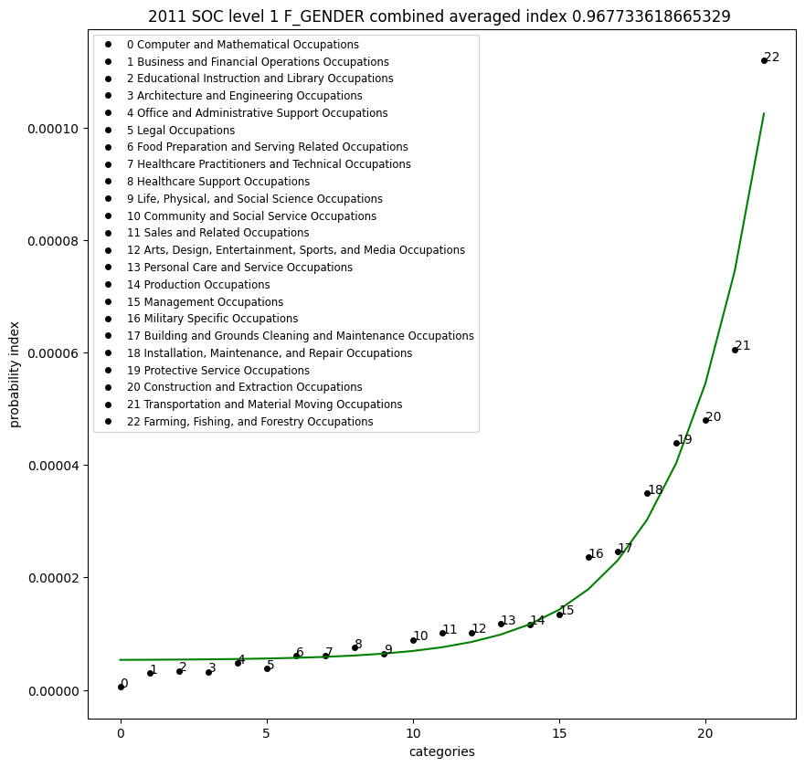
GENDER Fatality
data for 2011
R2 = 0.967

Slide 33
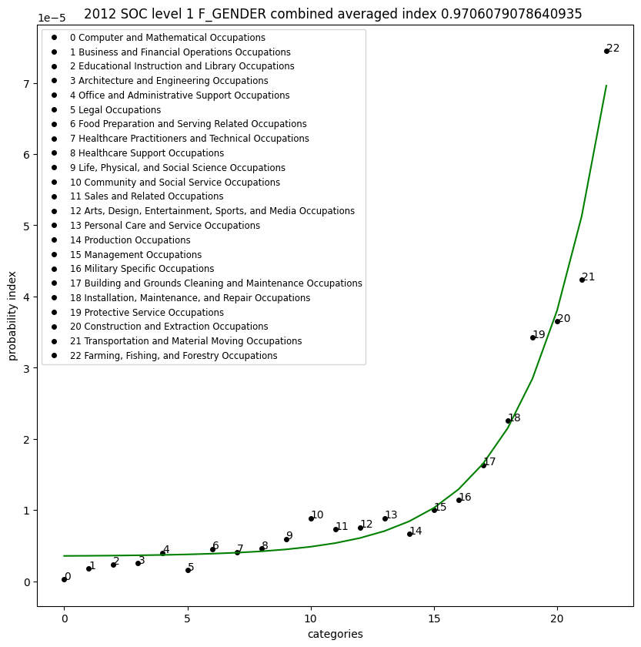
GENDER Fatality
data for 2012
R2 = 0.97

Slide 34
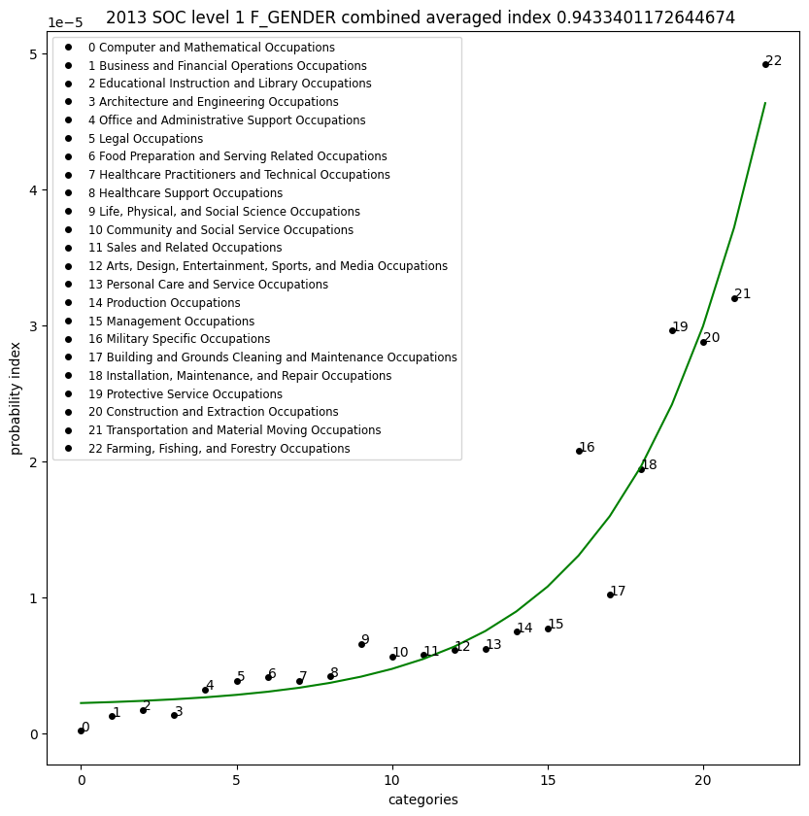
GENDER Fatality
data for 2012
R2 = 0.943

Slide 35
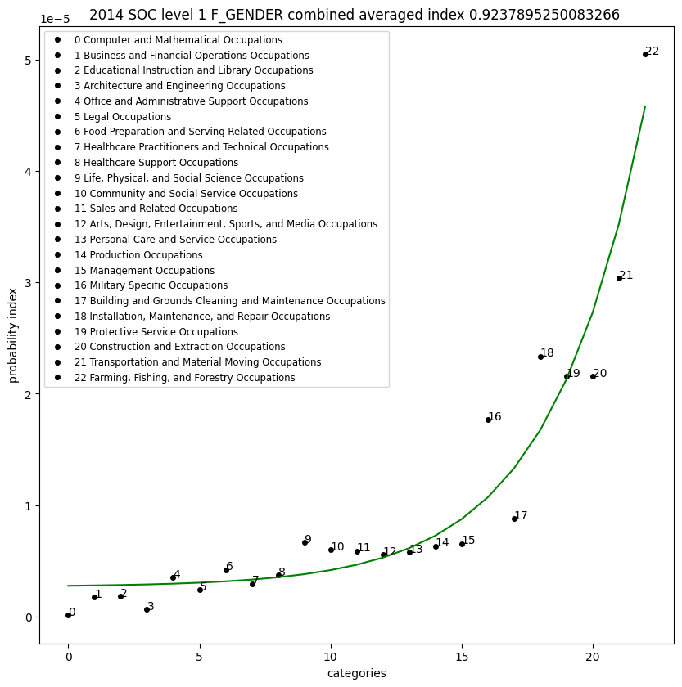
GENDER Fatality
data for 2012
R2 = 0.923

Slide 36
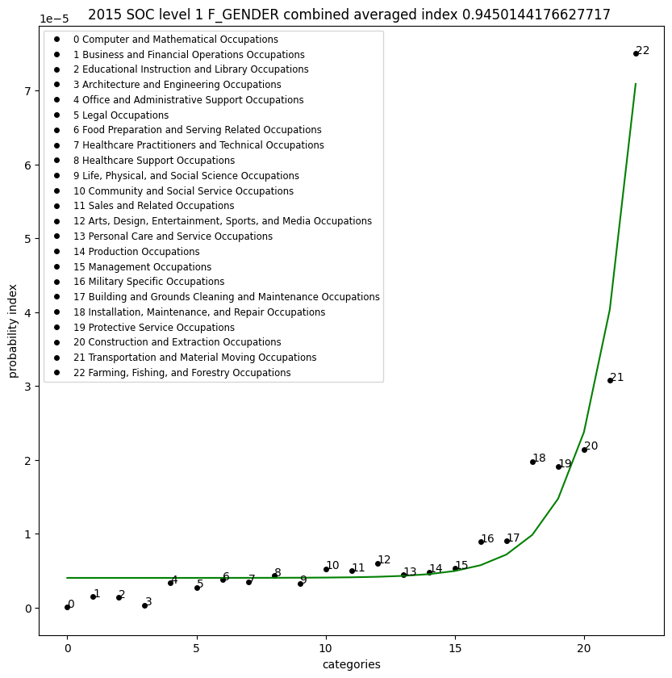
GENDER Fatality
data for 2012
R2 = 0.945

Slide 37
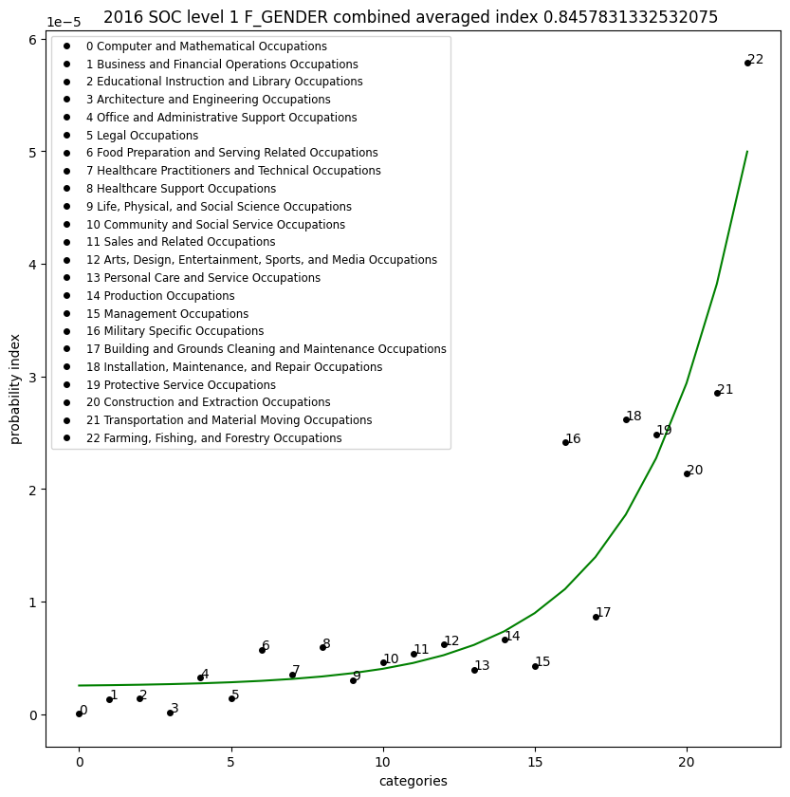
GENDER Fatality
data for 2012
R2 = 0.845

Slide 38
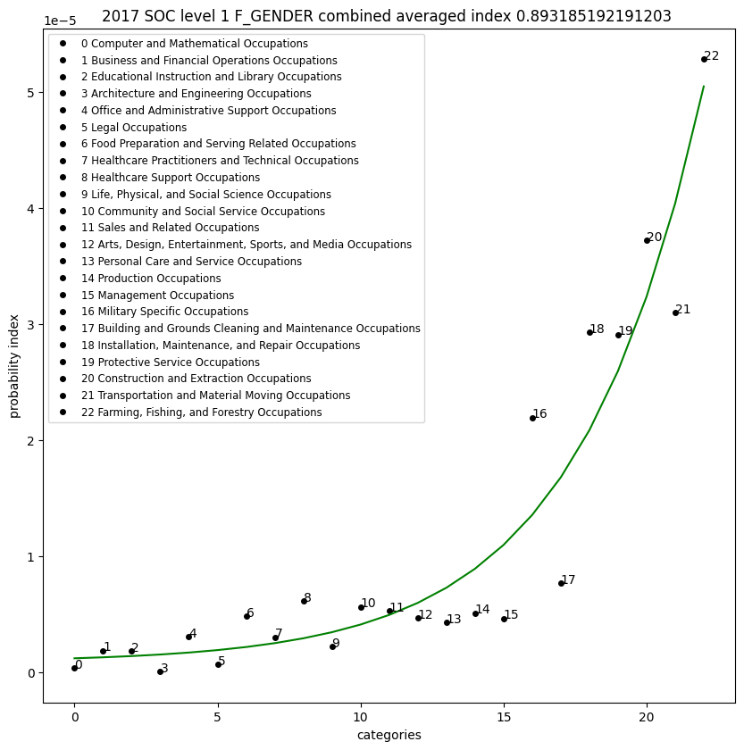
GENDER Fatality
data for 2012
R2 = 0.893

Slide 39
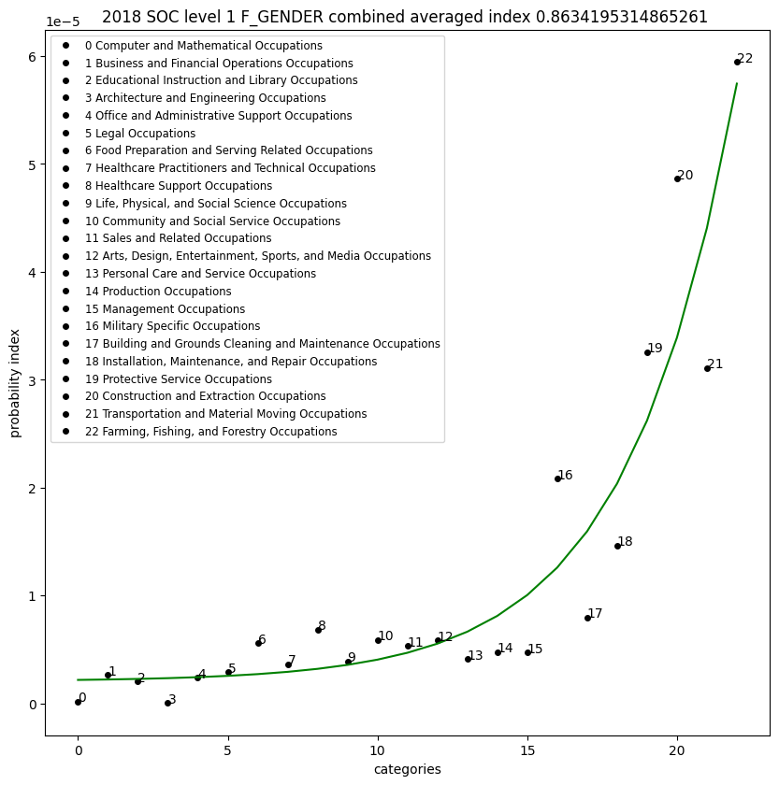
GENDER Fatality
data for 2012
R2 = 0.863

Slide 40
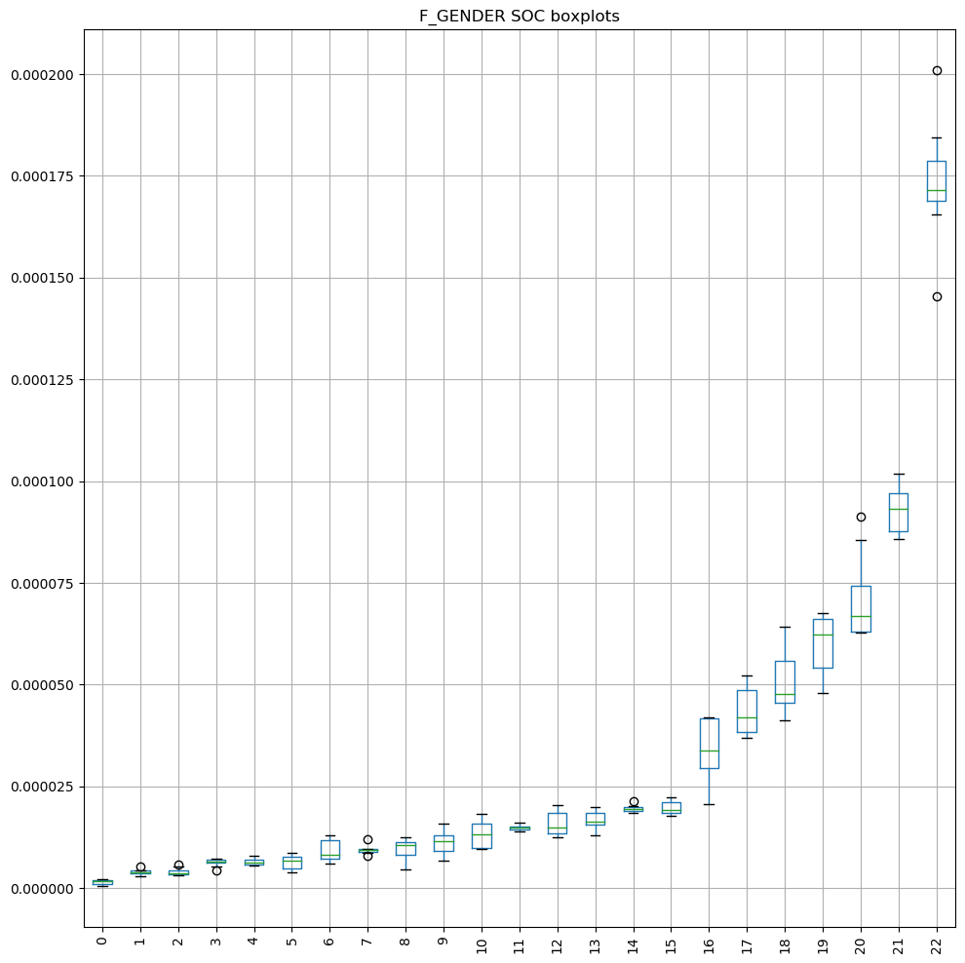
Occupational risk mathematical encoding.
The fatality GENDER distribution on the left below was used to demonstrate the distribution of fatalities over time for each occupational encoding. Each point on the X axis is an occupational class, and the box plot shown is the distribution of yearly data for those occupations. The plot on the right is the same data averaged and overlaid with the equation that best correlates to the exponential function.
Here we can see that relative to the other occupations over time the risk of fatalities
stays within a specified range that allows us to encode the risk of fatality with an equation
that uses an independent variable of occupation.

Slide 41
Gender Variable Equations
INDIVIDUAL PLOTS
The following plots are for GENDER fatalities per year
all the plots use the same occupational encoding.
Purpose of these plots
to show how the occupational risk equations for male and female
tracks the data over time
Two equations one for male and one for female respectively
will be used over time
In order to show how the equation performs over time.

Slide 42
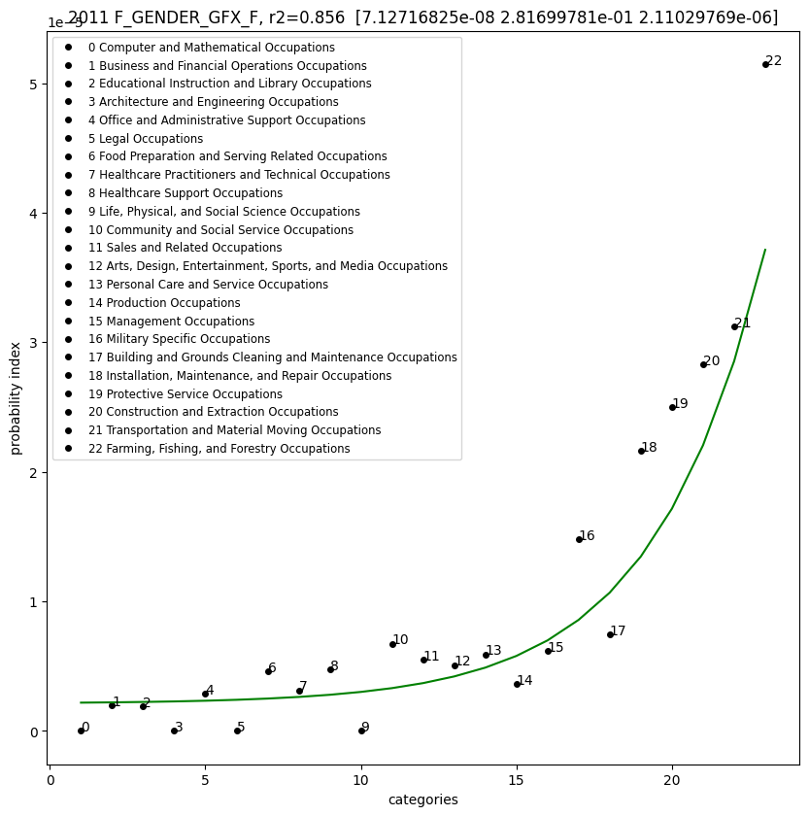
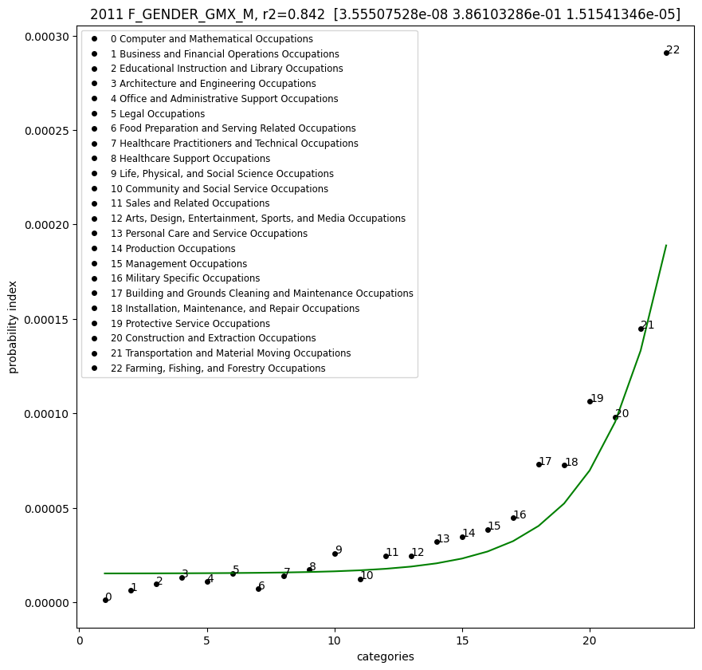
2011 FEMALE A = 7.13e-08 , B = 2.82e-01, C = 2.11e-06, r2= 0.856
2011 MALE A = 3.56e-08 , B = 3.86e-01, C = 1.52e-05, r2=0.842

Slide 43
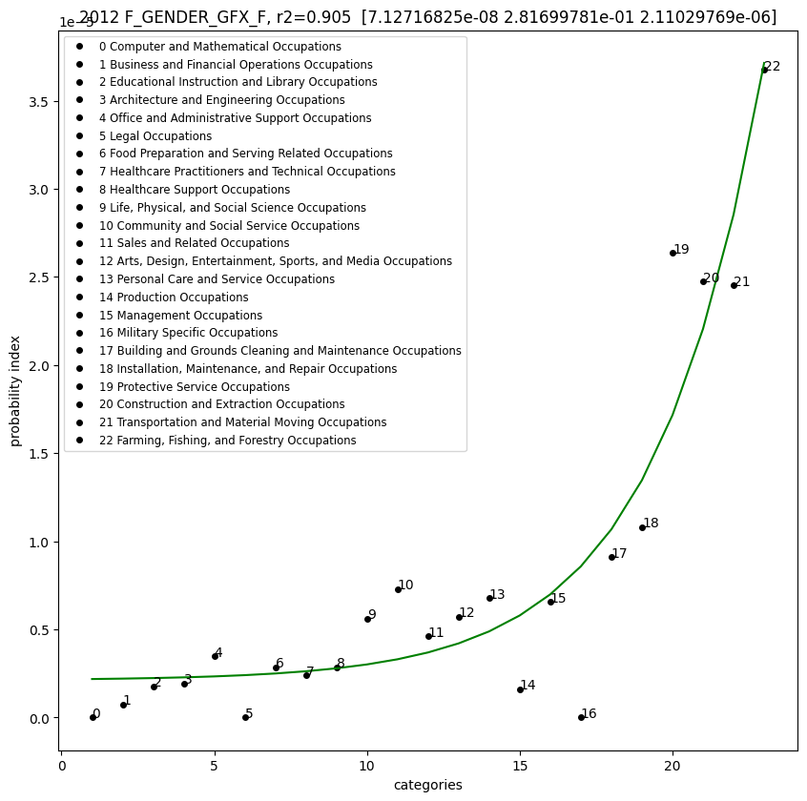
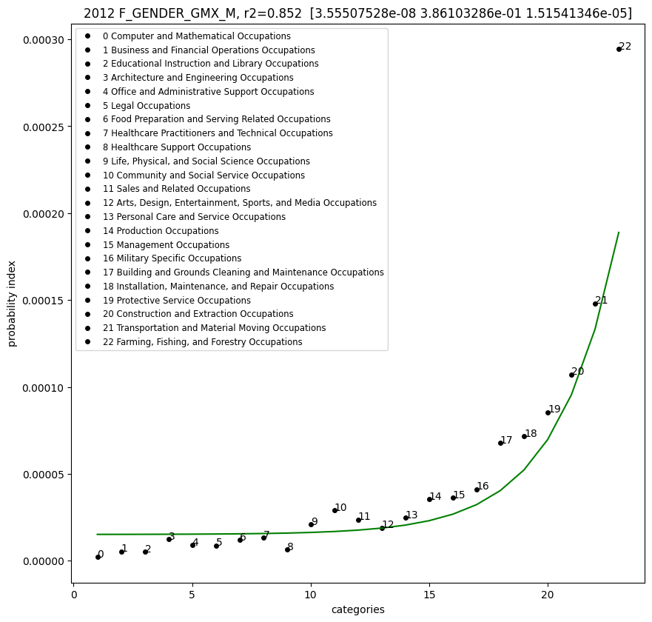
2012 FEMALE A = 7.13e-08 , B = 2.82e-01, C = 2.11e-06, r2=0.905
2012 MALE A = 3.56e-08 , B = 3.86e-01, C = 1.52e-05, r2=0.852

Slide 44
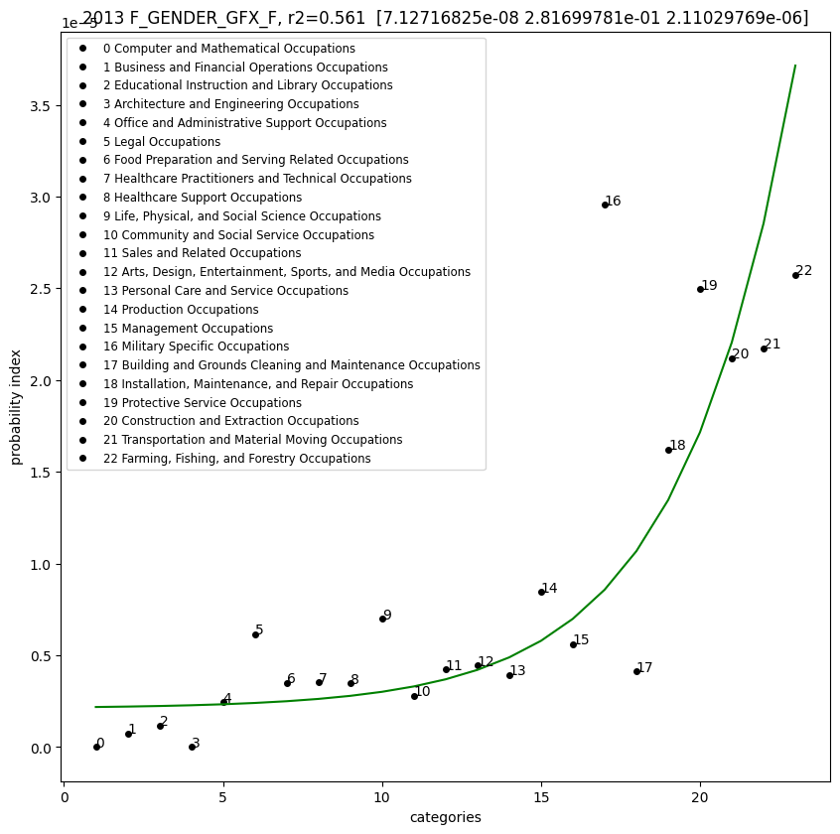
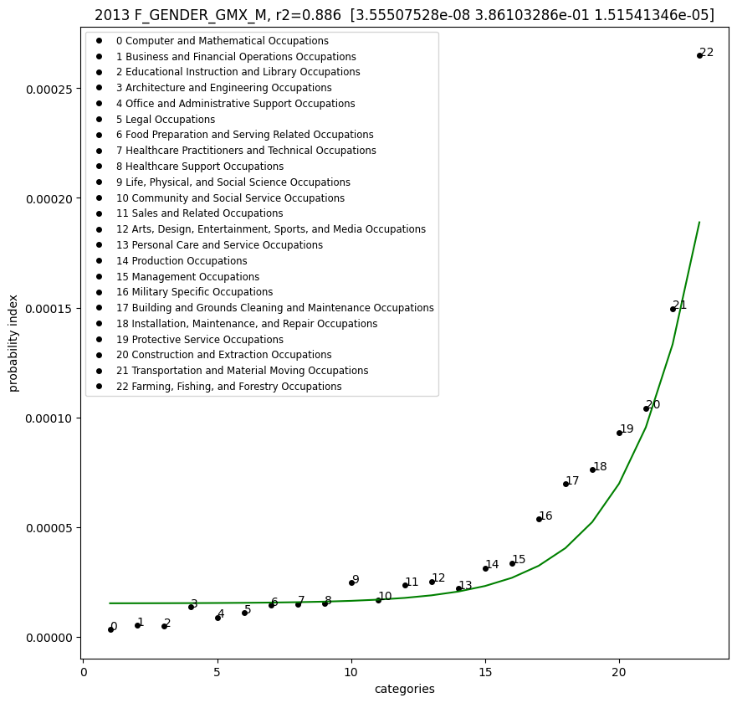
2013 FEMALE A = 7.13e-08 , B = 2.82e-01, C = 2.11e-06, r2=0.561
2013 MALE A = 3.56e-08 , B = 3.86e-01, C = 1.52e-05, r2=0.886

Slide 45
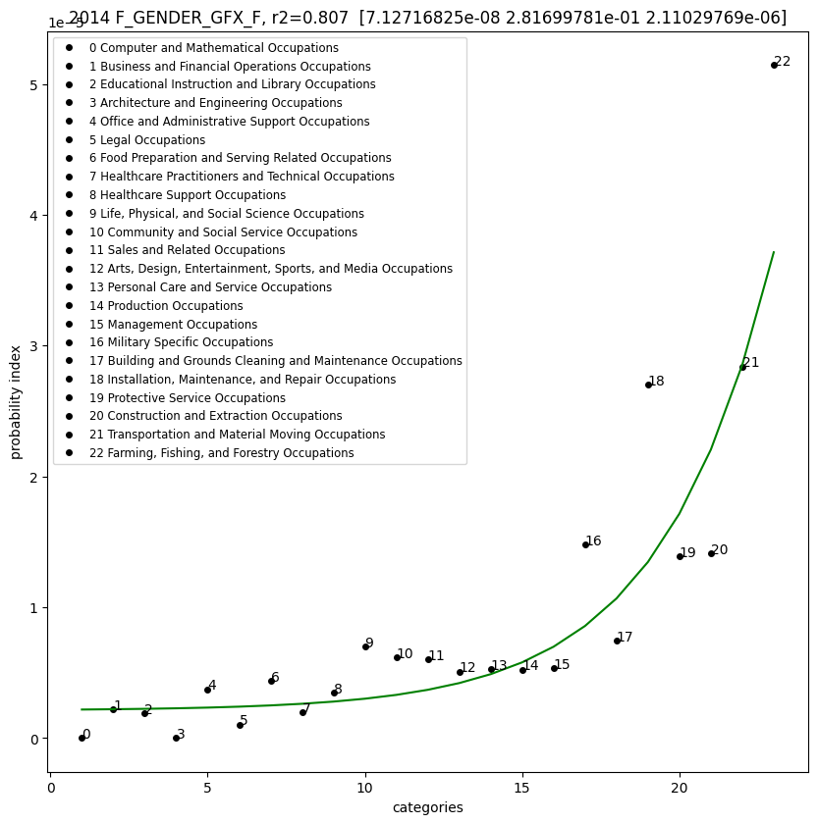
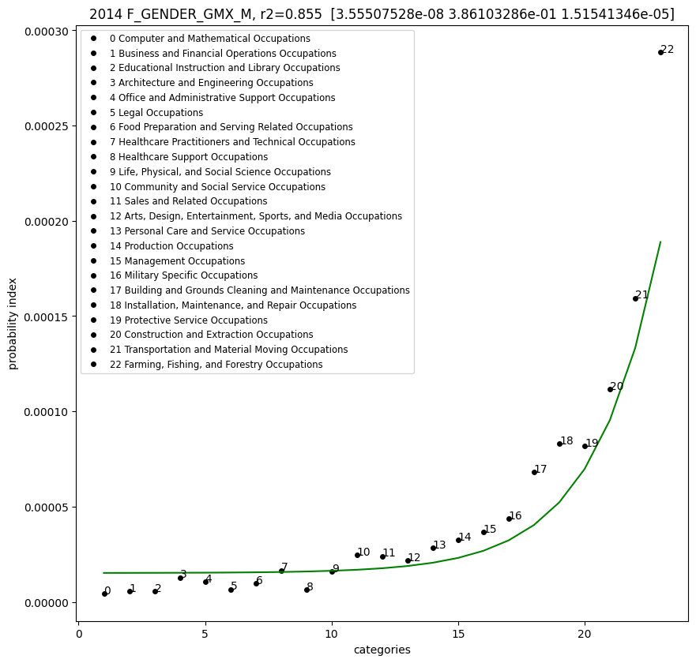
2014 FEMALE A = 7.13e-08 , B = 2.82e-01, C = 2.11e-06, r2=0.807
2014 MALE A = 3.56e-08 , B = 3.86e-01, C = 1.52e-05, r2=0.855

Slide 46
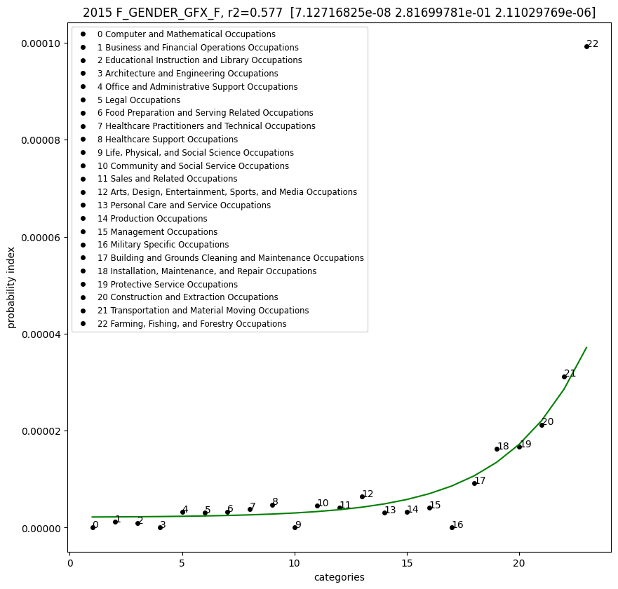
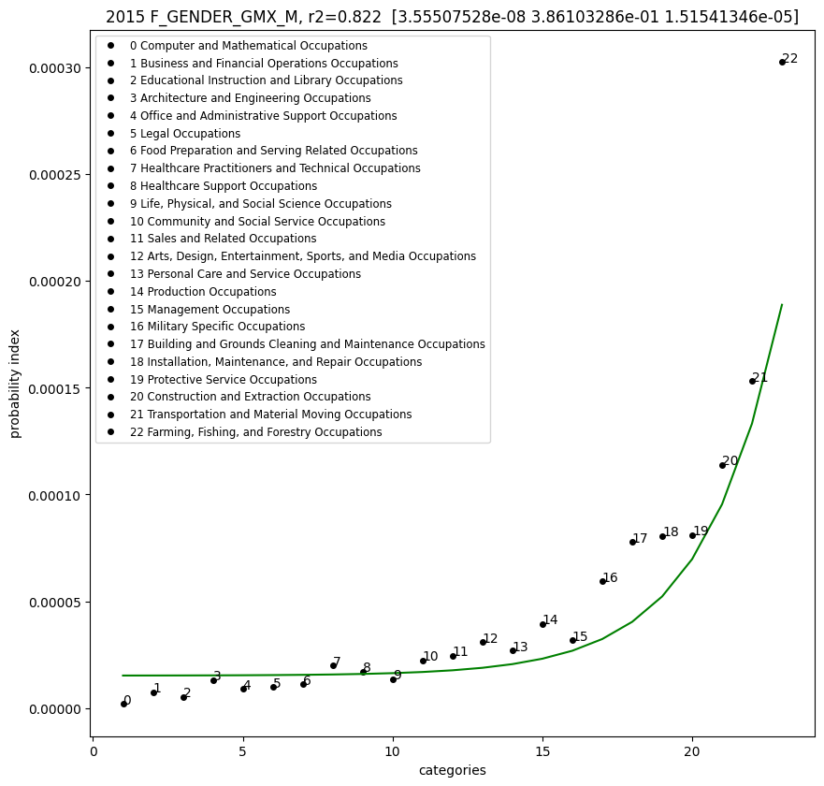
2015 FEMALE A = 7.13e-08 , B = 2.82e-01, C = 2.11e-06. r2=0.577
2015 MALE A = 3.56e-08 , B = 3.86e-01, C = 1.52e-05, r2=0.822

Slide 47
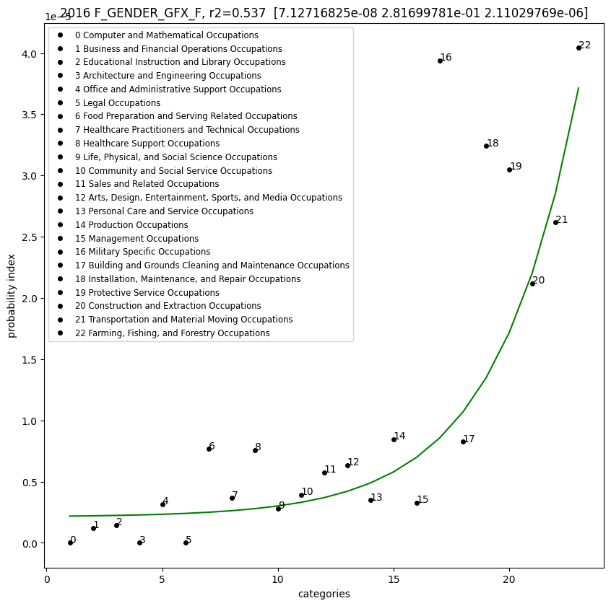
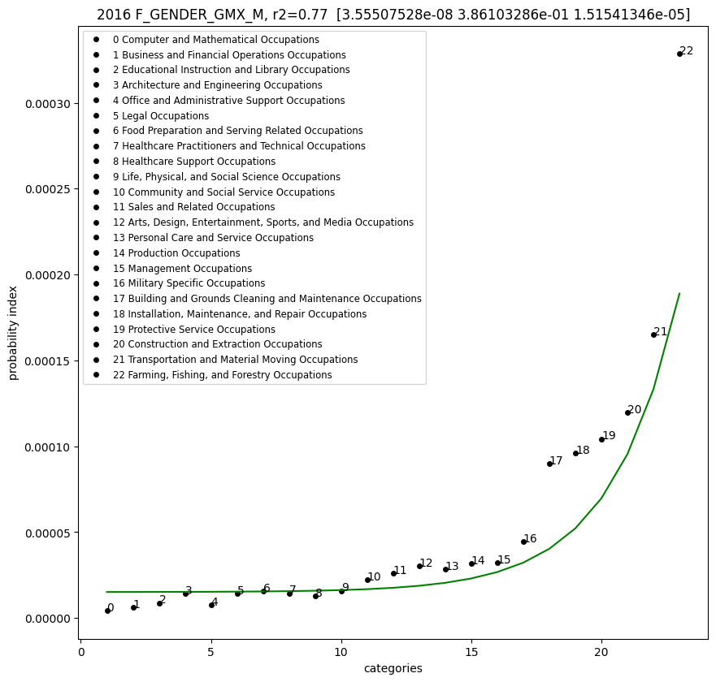
2016 FEMALE A = 7.13e-08 , B = 2.82e-01, C = 2.11e-06, r2=0.537
2016 MALE A = 3.56e-08 , B = 3.86e-01, C = 1.52e-05, r2=0.77

Slide 48
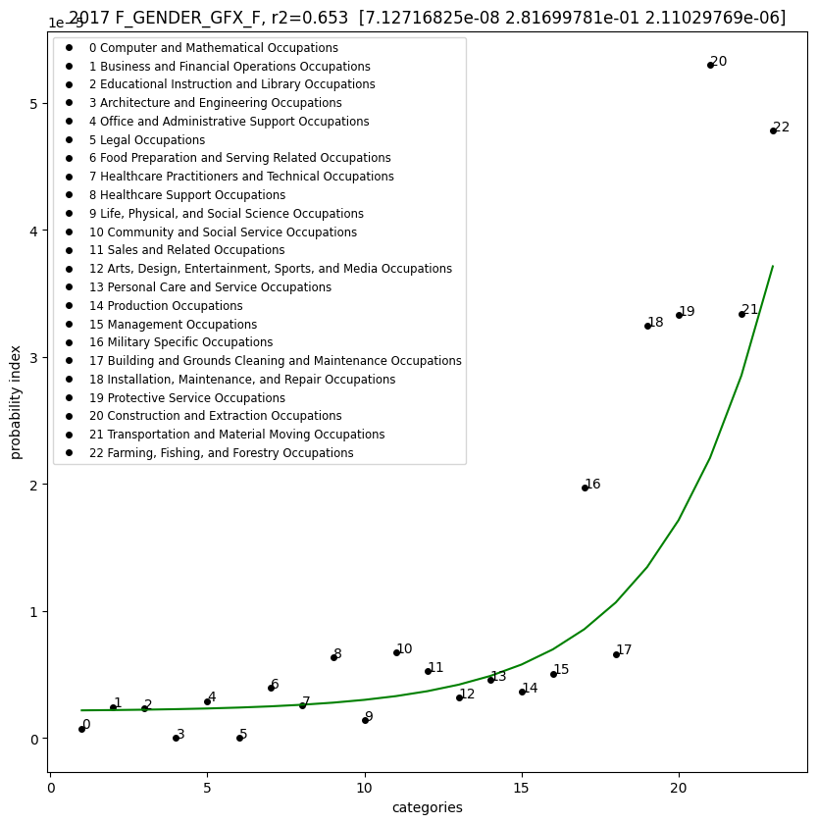

2017 FEMALE A = 7.13e-08 , B = 2.82e-01, C = 2.11e-06, r2=0.653
2017 MALE A = 3.56e-08 , B = 3.86e-01, C = 1.52e-05, r2=0.813

Slide 49
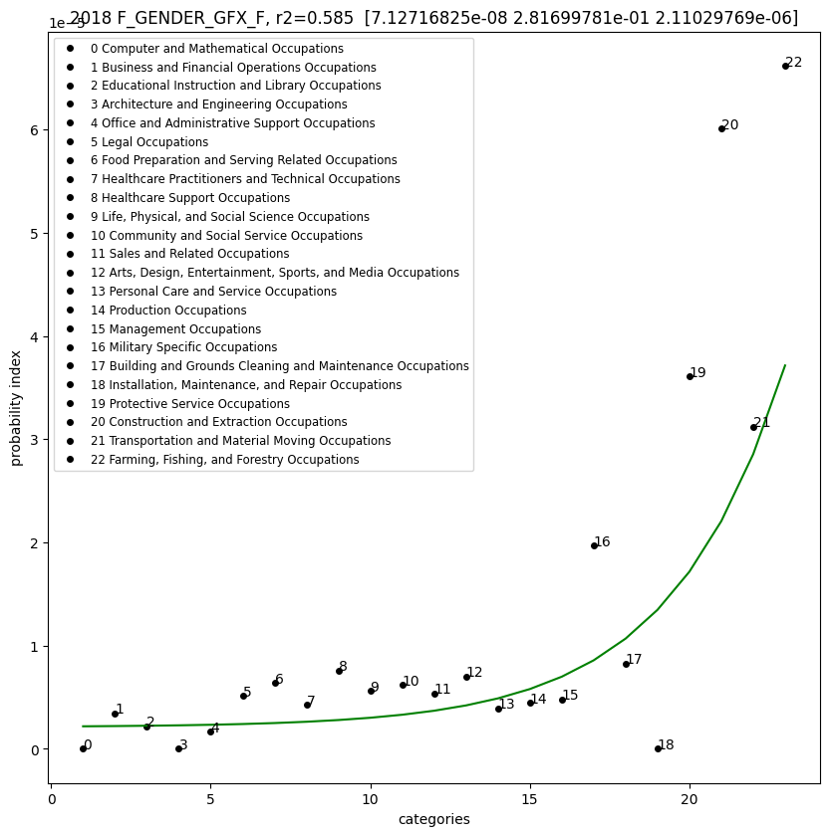
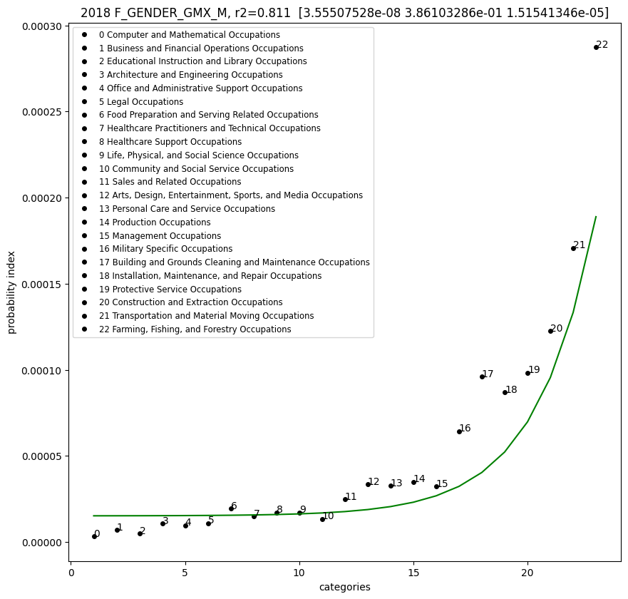
2018 FEMALE A = 7.13e-08 , B = 2.82e-01, C = 2.11e-06, r2=0.585
2018 MALE A = 3.56e-08 , B = 3.86e-01, C = 1.52e-05, r2=0.811

Slide 50
BOX PLOTS
F_GENDER
Note:
The following section uses boxplots along with a R squared correlation result, in order to demonstrate
the same analysis however with fewer plots. All of the plots have been captured and are available in the
GITHUB repository, however the amount of plots would overwhelm this presentation, if included.

Slide 51
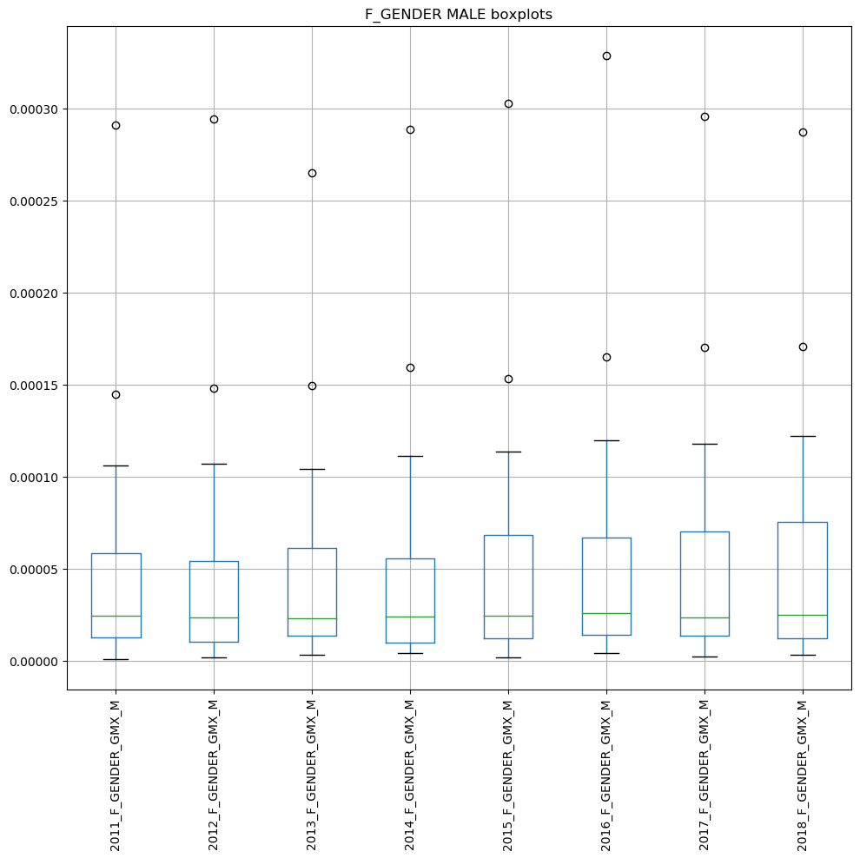
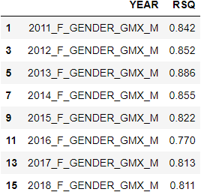

Slide 52
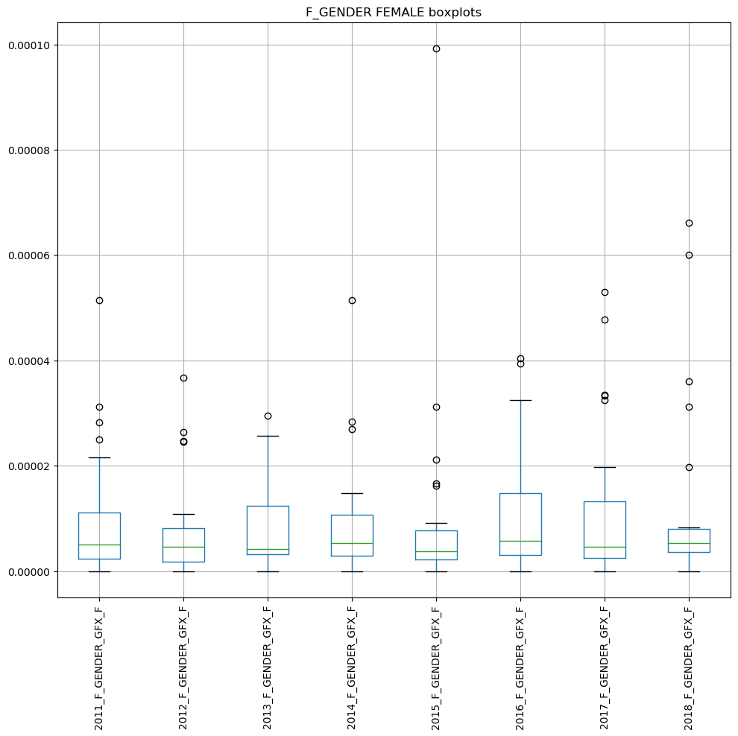
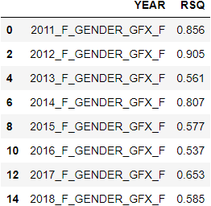

Slide 53
BOX PLOTS
F_AGE

Slide 54
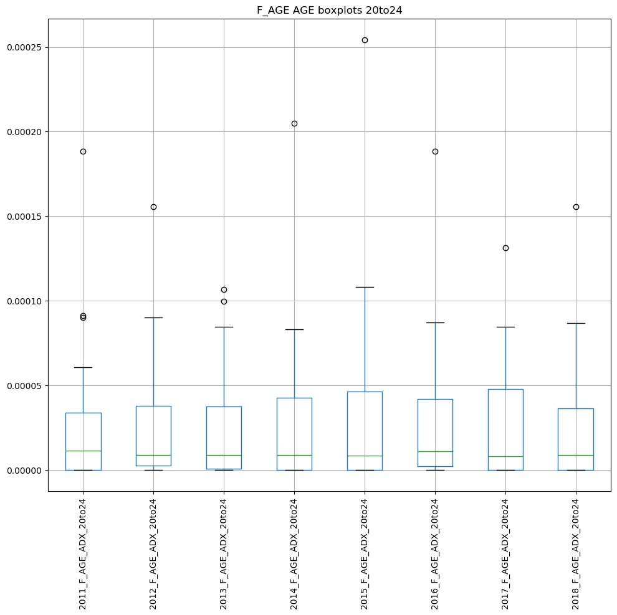
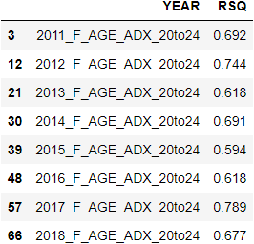

Slide 55
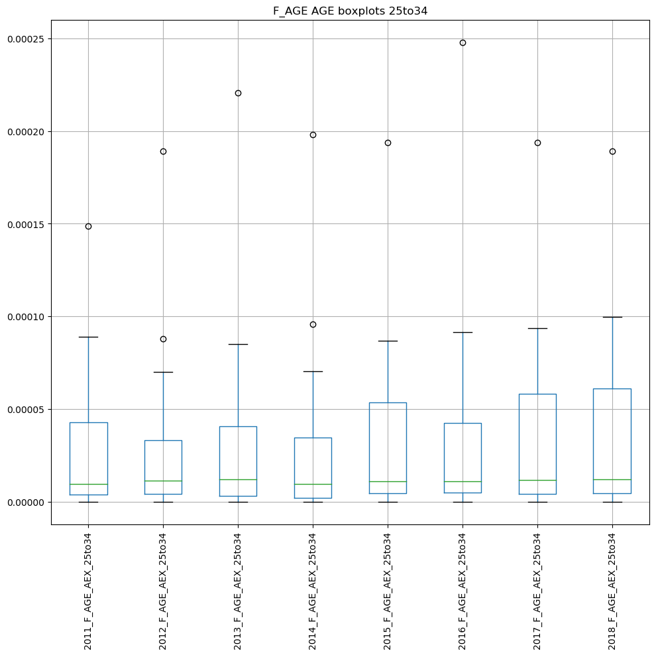
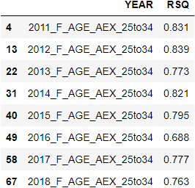

Slide 56
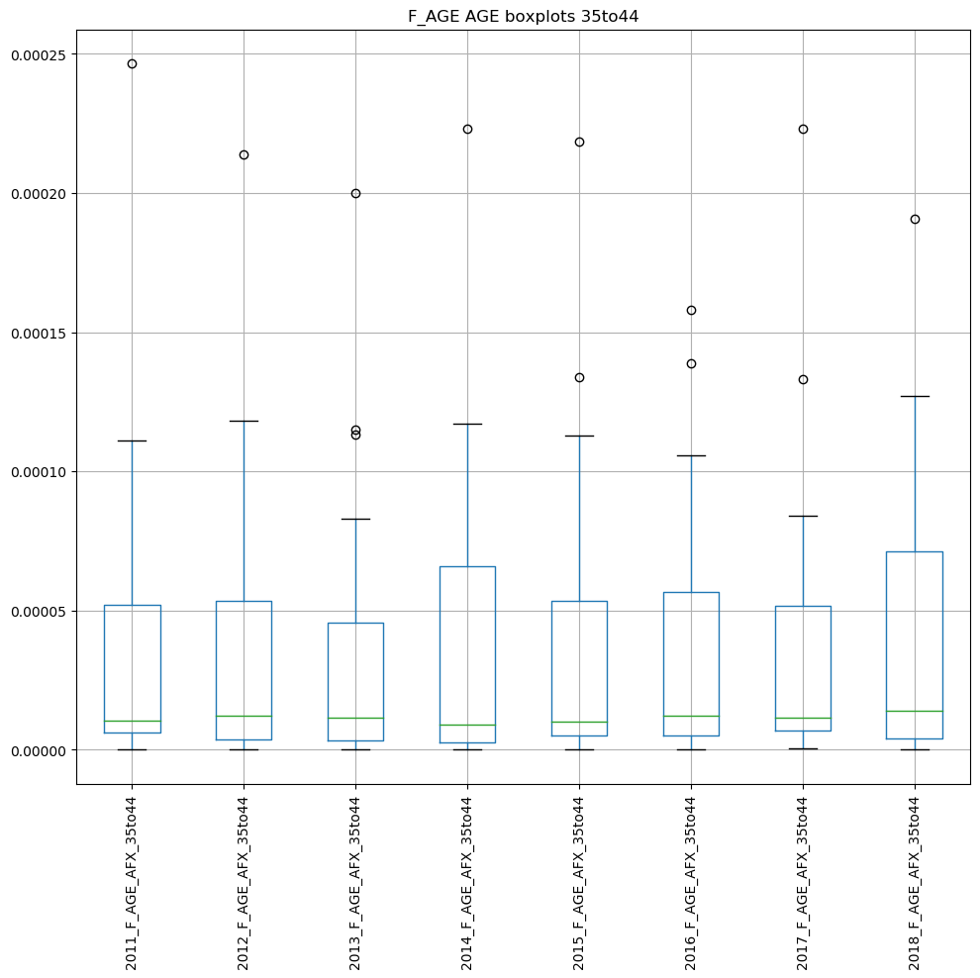
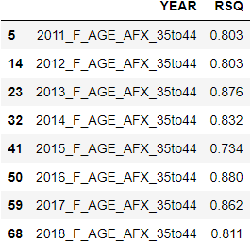

Slide 57
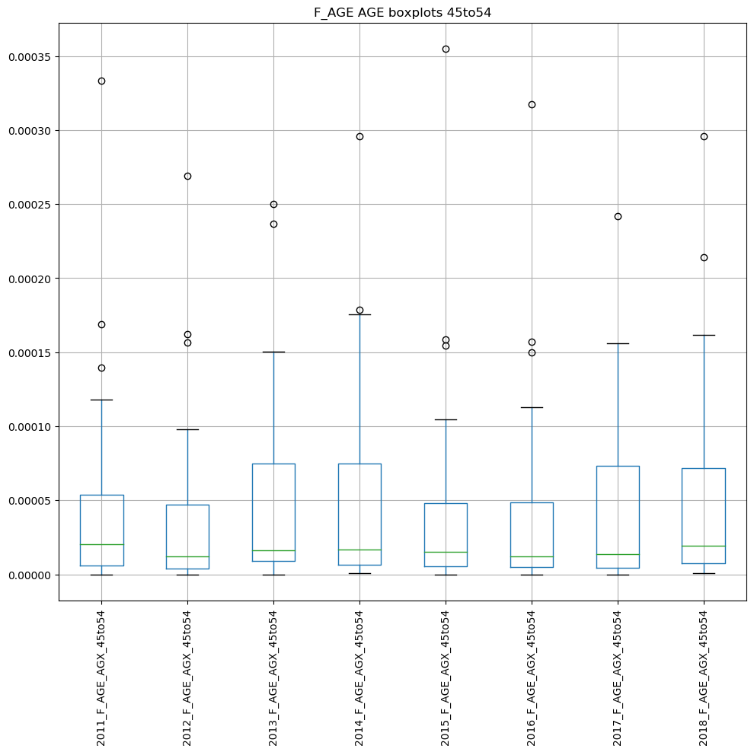
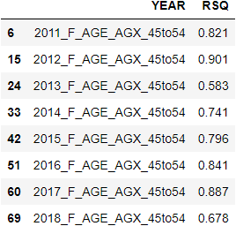

Slide 58
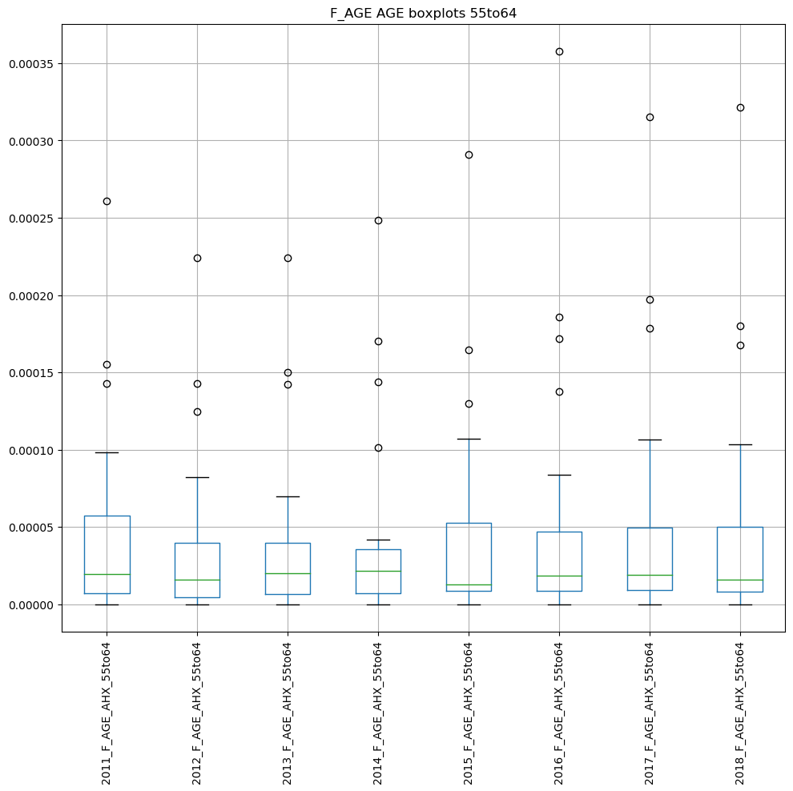
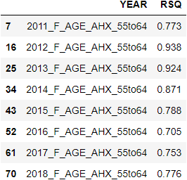

Slide 59
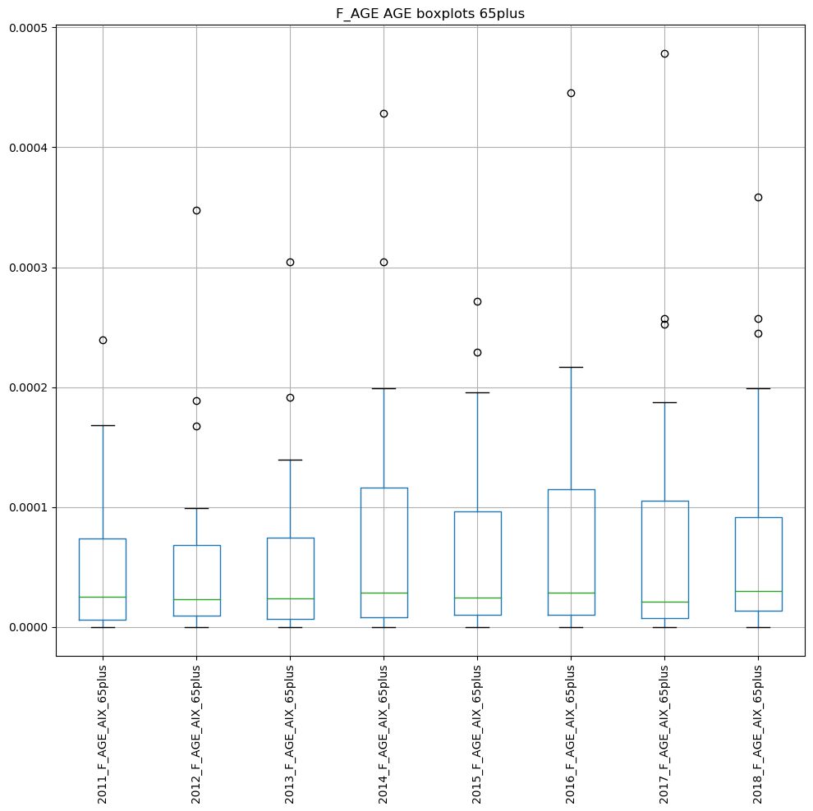
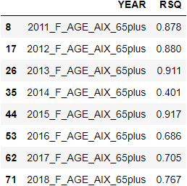

Slide 60
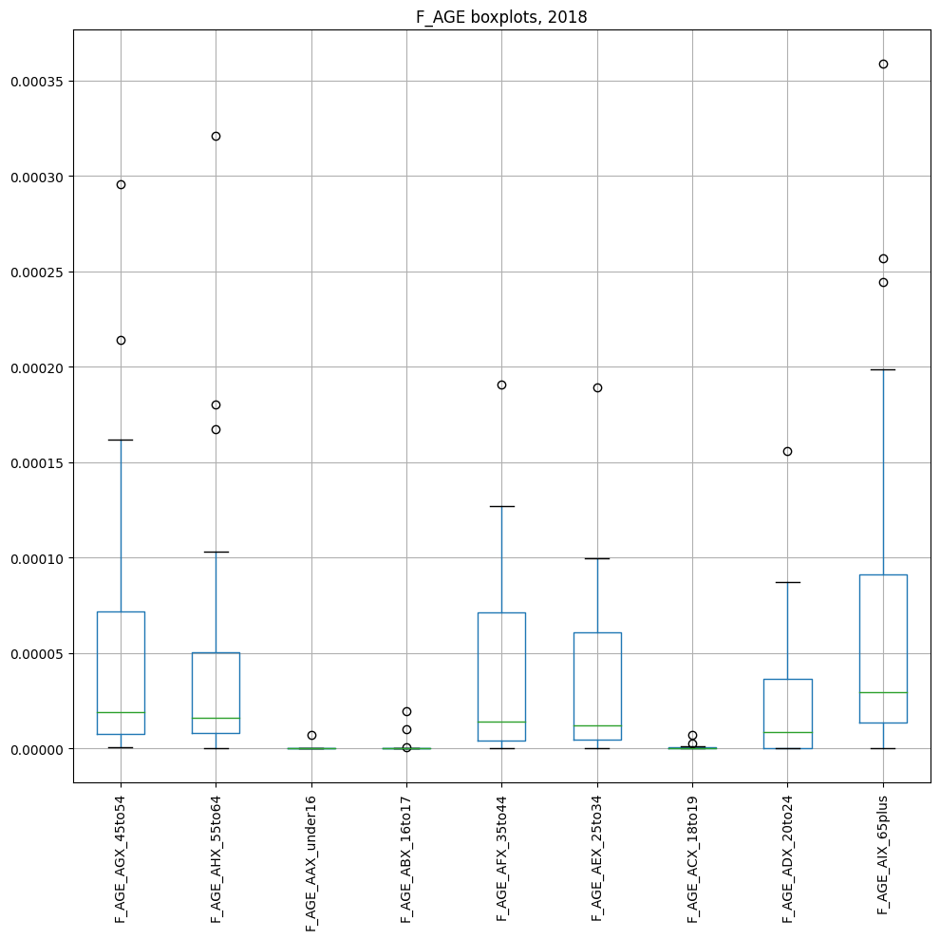

Slide 61
BOX PLOTS
F_RACE

Slide 62

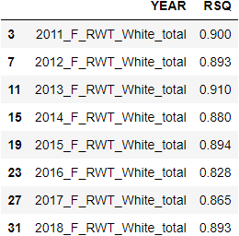

Slide 63
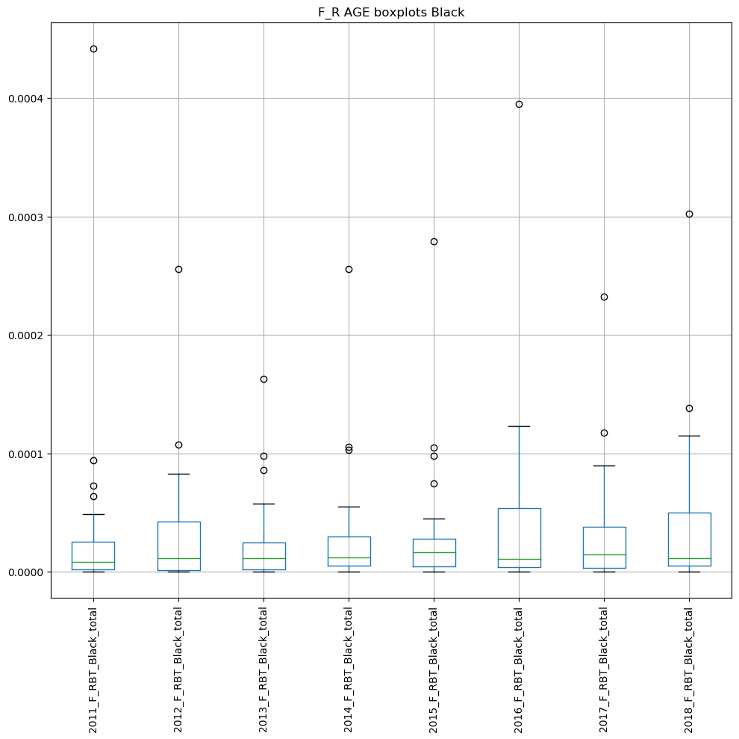
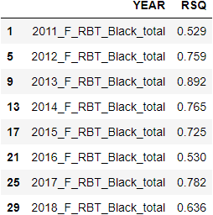

Slide 64
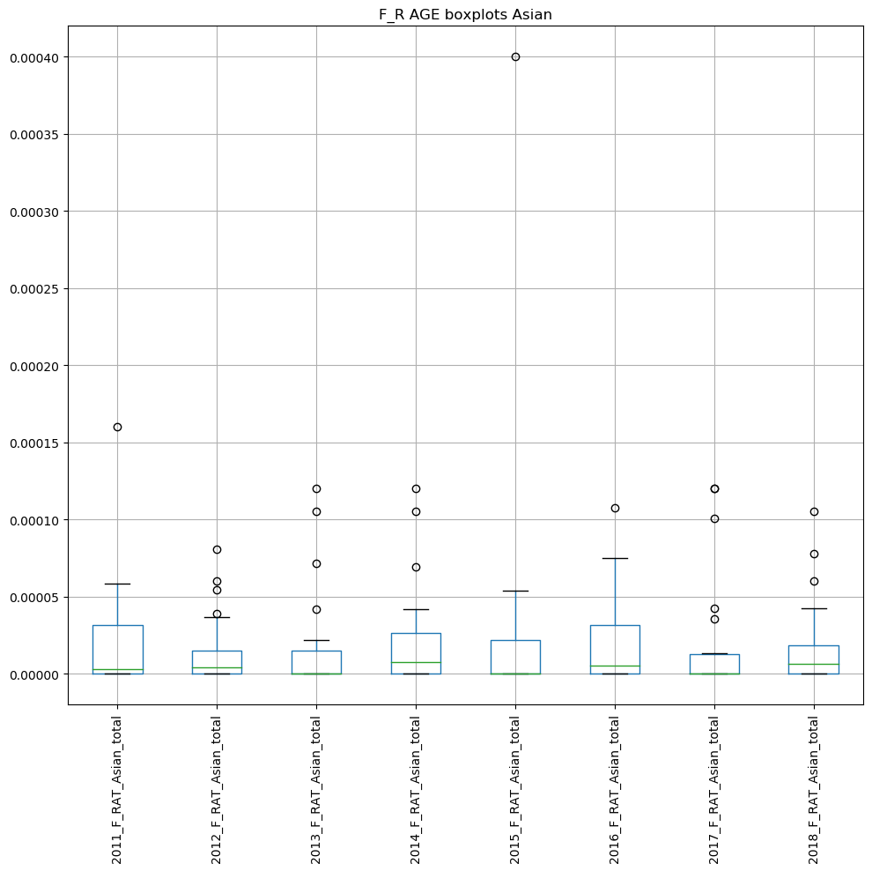
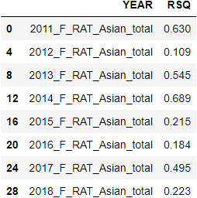

Slide 65
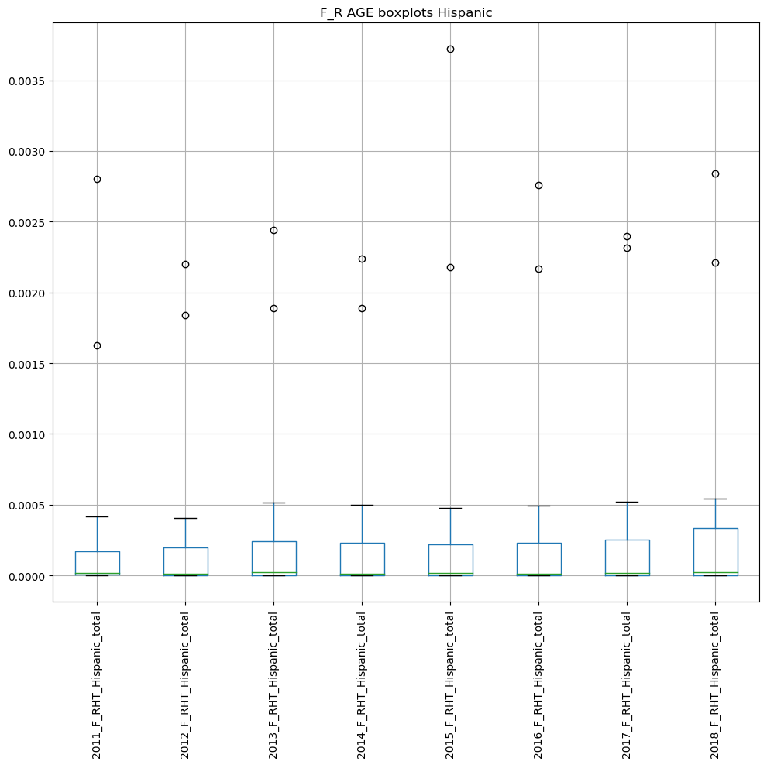


Slide 66
BOX PLOTS
NF_GENDER
(injuries)

Slide 67



Slide 68



Slide 69
BOX PLOTS
NF_AGE
(injuries)

Slide 70



Slide 71



Slide 72



Slide 73



Slide 74



Slide 75



Slide 76
BOX PLOTS
NF_RACE
(injuries)

Slide 77



Slide 78



Slide 79



Slide 80



Slide 81
Fatality correlations
To Injuries

Slide 82

Note:
Since there are to many correlations, the correlations will be
broken down in the subsequent pages

Slide 83
CORRELATIONS - GENDER

Slide 84



Slide 85
CORRELATIONS - AGE

Slide 86


Slide 87


Slide 88
CORRELATIONS – NATURE

Slide 89


Slide 90


Slide 91
CORRELATIONS – RACE

Slide 92


Slide 93


Slide 94
CORRELATIONS – EVENT

Slide 95


Slide 96


Slide 97
HISPANIC CORRELATION
ANALYSIS

Slide 98

Fatalities

Slide 99

Injuries ??

Slide 100


Injury comparison to White and Black

Slide 101
Injuries ??
All data was double checked, to ensure no mistake was introduced.
Also verified that proper total Hispanic normalization was correct.
In the Farming, Construction, and Building Maintenance, there seems to be an increased injury event. Given that this data was normalized to total Hispanics. For some reason, there is an increased injury probability.
Is this due to risk perception or some other some other systemic anomaly?
Note:
If it was not for this occupational mathematical encoding, this comparison to other races would not be evident.

Slide 102
LIMITATIONS/
RISK

Slide 103
Limitations / Potential Problems / Pitfalls and Risks
Limitations:
The study is limited to publicly available occupational injury data in the United States.
Since the injured population cannot be surveyed for risk perception, risk perception inferences will be made based on previous literature research.
There is no OSHA compliance data specific to the laboratory with the documented recordable case.
The study will not evaluate the existence of an association between compliance violations and injuries within the organization reporting the injury, illness or fatality. Therefore, based on the data available we will not be able to determine if there is an association between compliance, previous history of safety violations and the injured employee’s perception of risk.
Potential Problems / Pitfalls:
The current data interface has changed and data the process of collecting the data is now more cumbersome than before. There is no control on future changes.
The Department of Labor currently stores the data in a very fragmented way, which makes it difficult to access and consolidate for use.

Slide 104
Risks and Approvals
Risks:
It poses minimum to no risk but in turn the expected outcomes will provide public health and safety benefits as it will aim to establish an understanding on whether there is a correlation on how risk is perceived and occupational injuries in laboratory settings compared to those in manufacturing.
IRB Approval:
This study will be ran the Subject University Office of Research Integrity to collaborate that the research study is exempt via the Exempt Review process as it is a secondary data review and no people identifiers were collected, thus no identifiers will be included in the dataset for the purpose of the study.

Slide 105
REFERENCES

Slide 106
References
Cambridge University Press (2020). Definition of lagging indicator. Cambridge Advanced Learner's Dictionary & Thesaurus.
National Safety Council (2018, 2017). Injury Facts. Retrieved from: https://injuryfacts.nsc.org.
Occupational Safety and Health Administration (OSHA) (2001). Recording and Reporting Occupational Injuries and Illness, 29 C.F.R.§1904.7 Subpart C.
U.S. Bureau of Labor Statistics (2016). Current Population Survey. Census of Fatal Occupational Injuries.
U.S. Bureau of Labor Statistics (2020). Copyrights, publications, licensing and data protection. https://www.bls.gov/opub
U.S. Bureau of Labor Statistics (2020). Multi-screen data search for Injuries, Illnesses and Fatalities Data from 2011-2018. https://www.bls.gov/iif/data.htm

Slide 107
Figures
Figures
Figure 1: Graphical Representation of Hypothesis.
Figure 2: Risk Perception Model.

Slide 108
Tables
Table 1
Dependent and Independent Variables.
Table 2
Description of Independent Variables.

Slide 109
PROGRESS ACTION PLAN

Slide 110
Timeline (January – Dec 2021)
NIH
Submission
1 month
D2, D3
Committee Review
Sept-Oct’21-D2
Dec’21-D3 Tentative
0-3 months
Report Writing
Send Update.
July-Sept’21
0-3 months
Data Analysis
Aims 1 and 2
Send Update.
May-June’21
0-2 months
Draft Proposal Development
Presentation to Committee
Mar-Apr’21
0-2 months
D1r approval.
Send Update.
Data source Feasibility
Project redesign
Jan- Mar’21
Completed
On track
Late
Notes:
Data collection: 0-3 months
Data analysis for Aim 1 (A and B): 0–3 months
Data analysis for Aim 2: 0–3 months
Preparation of NIH Annual reports: 0–3 months

Slide 111
BACKUP SLIDES

Slide 112
Example Data:
More data can be found within the PLOTS directory:
The next slide shows the plot of relative fatal log10 index vs increasing SOC categories level 1. 11XXXX, 12XXXX, 13XXXX…., for the GENDER category.
The slide after that, shows the plot of relative fatal log10 index vs increasing SOC categories level 6. 110000, 111000, 111010…., for the GENDER category.
OBSERVATIONS:
Since, the relative index is a function of, y_{log} = [-1 * log10(y_{data})], then a higher relative log index value correlates to a small fatality/injury rate. Since the categories on the x axis are ranked from left to right with increasing job risk. We can see a positive slope, that indicates that people with a higher perception of risk have a lower fatality rate.
We also believe that we see a relationship of injury count, fatal count, and soc_code combination. Therefore, we should be able to predict a fatality count given an soc_code and injury count.
Any other suggestions as to what other potential statistical measurements we can perform, would be appreciated?
https://github.com/ehsintegration/yfd-phd-bls-data/tree/master/PLOTS

